Slide 1




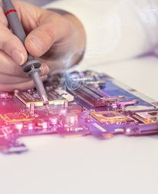



Slide 2
What + If = IEEE
Membership
Communities
Conferences
Publications
Standards
Education
Career Resources
Humanitarian and Philanthropic Goals
Awards
Industry
Inventive minds utilize IEEE intellectual resources to improve what matters most in our lives.

Slide 3

The Fuel of IEEE: Mission & Vision
IEEE is where forward-thinking technology professionals come together—in the spirit of collaboration—to discover the next technological innovation, develop international standards, and form communities to share research, education, and humanitarian goals.
Our Mission
The core purpose of IEEE is to foster technological innovation and excellence for the benefit of humanity.
Our Vision
IEEE will be essential to the global technical community and to technical professionals everywhere; and be universally recognized for the contributions of technology and of technical professionals in improving global conditions.
Notes:
IEEE and its members stretch far beyond just engineering, IEEE wants to look at the big picture and solve global problems.
What does that mean?
It means that IEEE wants to:
Expand and enable diverse communities to help individuals from around the world to share, collaborate, network, debate, and engage with one another.
Provide technically vital forums for the discussion, development, and dissemination of authoritative knowledge related to traditional, emerging and disruptive technologies.
Lead humanitarian efforts around the world to use technology to solve the world’s most challenging problems.
Leverage IEEE’s technology-related insight to provide governments, NGOs and other organizations, and the public with innovative and practical recommendations to address public policy issues.
To achieve that, we have business solutions that are vital to both companies and their employees.

Slide 4
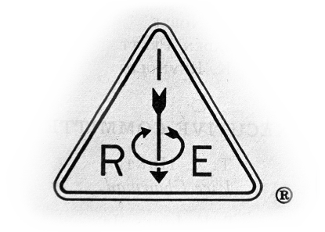


The Founding of IEEE
1884
1912
1963
TODAY
AIEE
American Institute
of Electrical Engineers
IRE
Institute of Radio
Engineers
IEEE embodies the visions of its founders—applying them to the challenges of today and tomorrow.
Learn more: ieee.org/about/ieee-history.html

Slide 5
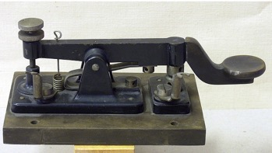

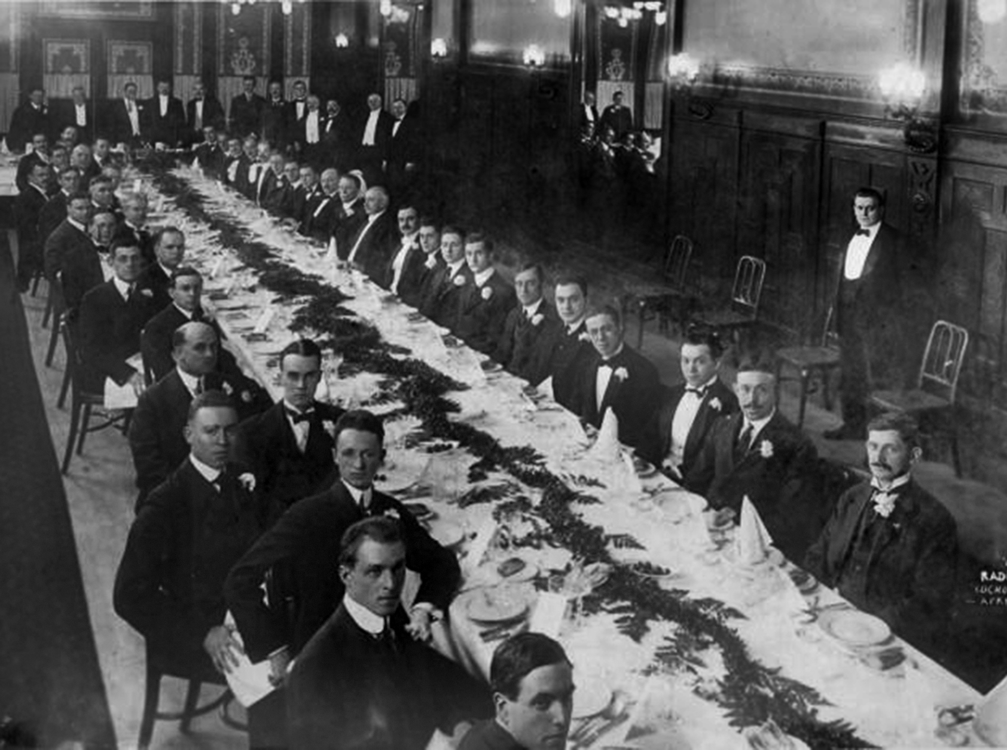
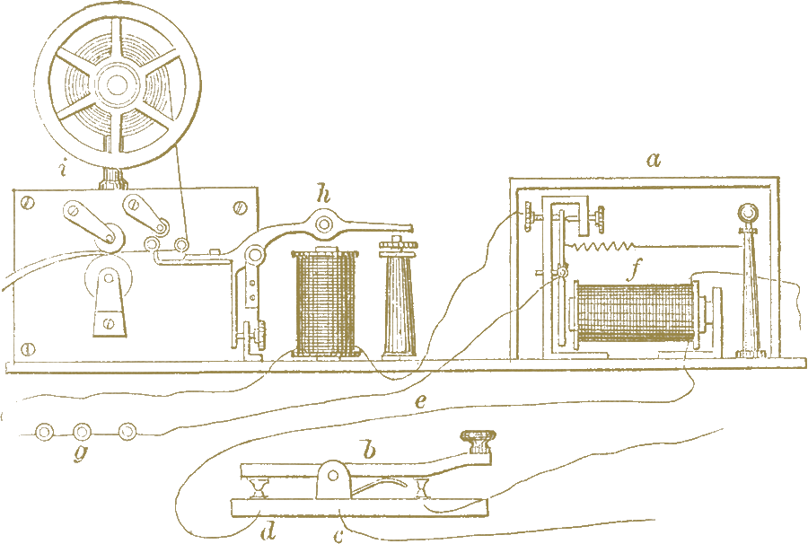

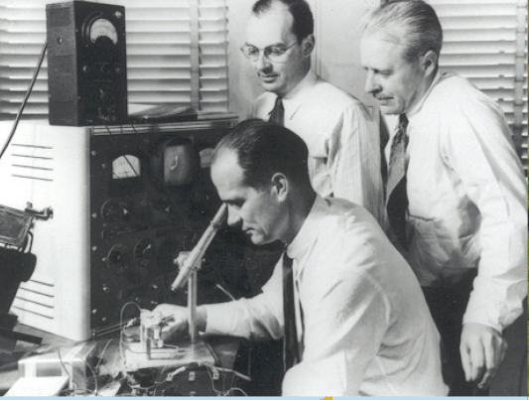
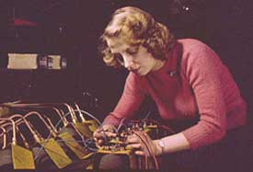
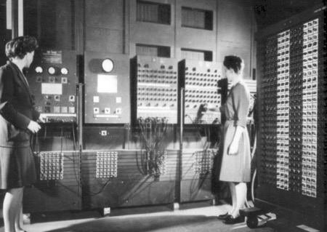
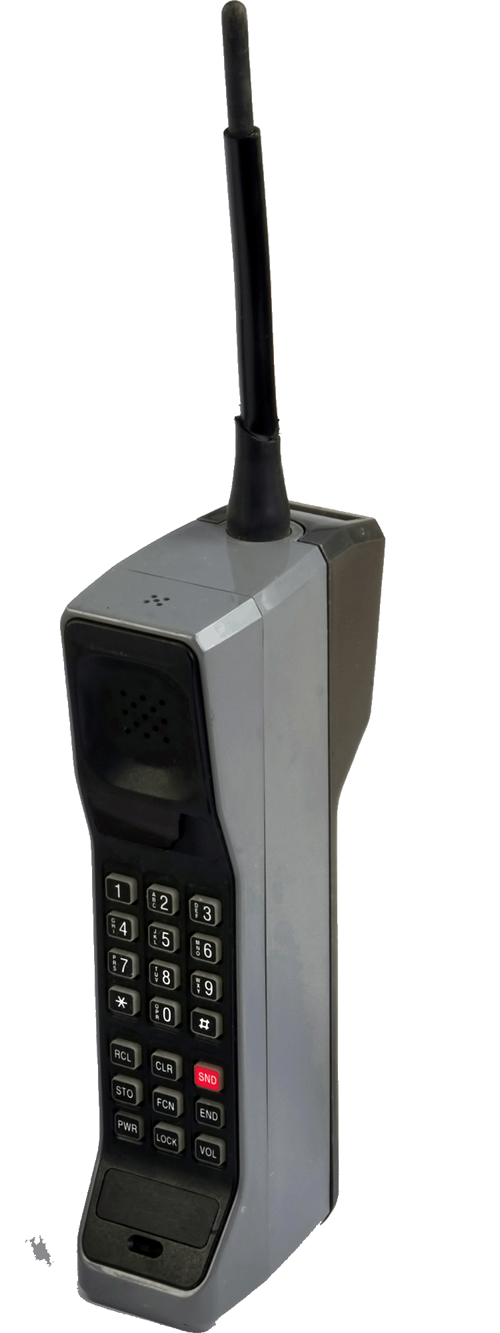
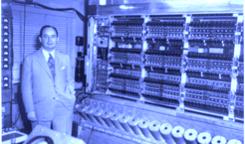
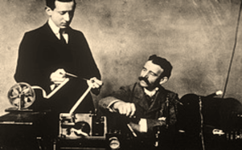
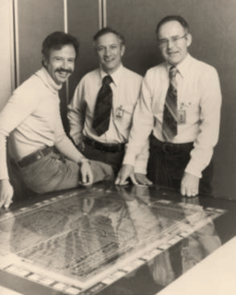
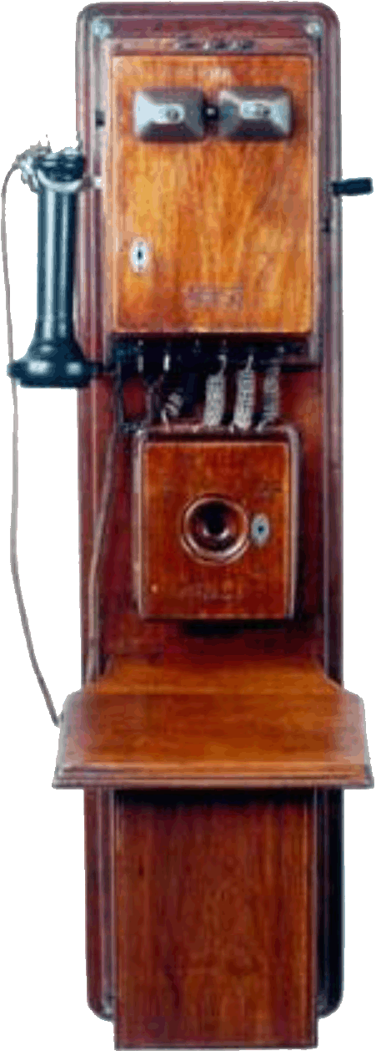
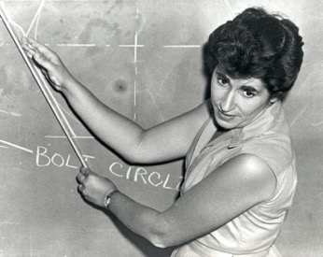

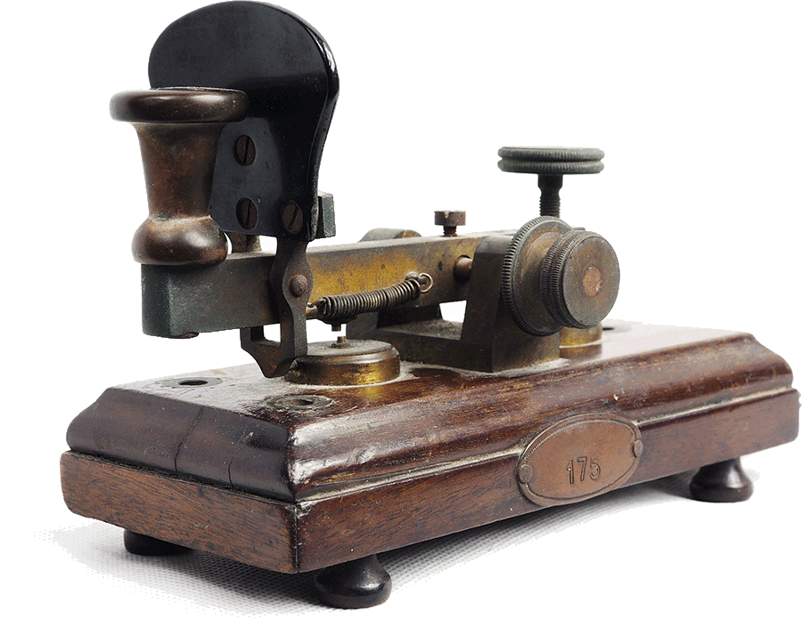
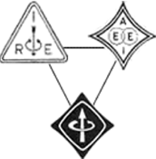
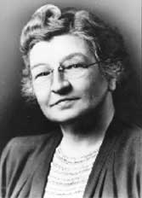
The History of IEEE
Our story begins with the spirit of collaboration
to light up and connect the world…and continues today,
as we find innovative solutions to global challenges.
Learn more: ieee.org/about/ieee-history.html

Slide 6

The IEEE Promise
The IEEE brand is an authentic reflection of our unflagging dedication to:
Maintain our leadership as a trusted source of advancements and applications of technology
Create standards, innovative research venues, and a global technology forum
Provide opportunities to conquer technical challenges
with imagination
Enable today’s innovators to improve
tomorrow’s quality of life
IEEE IS RECOGNIZED AS:
A leader in the influence of the global technology community
A resource to the technology industry within various disciplines for the engineering community
A supporter of innovation with new technology standards and publications that empower tomorrow’s advancements
Learn more: brand-experience.ieee.org/ieee-brand/brand-overview/

Slide 7








IEEE Today at a Glance
39
Technical
Societies
Global
Reach
400,000+
Members
160+
Countries
60% of whom are from outside the US
and seven
Technical Councils
across 10 geographic Regions
1,600+
Annual Conferences
5,000,000+
Technical Documents
200+
Top-cited Periodicals
1,200+
Active Standards
Technical Breadth
in 96 countries while contributing over 3.6 million total conference papers to IEEE Xplore® since 1936
via IEEE Xplore digital library, with more than 15 million downloads each month
IEEE journals, conference proceedings, and select content dating back to 1884
and 900+
more in development
Learn more: ieee.org/about/at-a-glance.html

Slide 8

Technical Expertise that is Broad and Deep
IEEE provides thought leadership and resources for the global tech community.
Aerospace & Defense
Biomedical Engineering
Broadcasting
Circuits
Communications
Computer Science
Control and Automation
Cyber Security
Electronics
Environment
Industrial systems
Information Technology
Internet of Things
Life Sciences
Nanotechnology
Optics
Power and Energy
Robotics and AI
Semiconductors
Smart Cities
Smart Grid
Sustainable Energy
Transportation and Vehicles
And more…
Notes:
IEEE facilitates the cross-pollination of ideas, giving people access to ideas developed in other disciplines.

Slide 9








Top Organizations Innovate with IEEE
Whenever technology happens, IEEE is there.
All Top 5
Communications Equipment Companies Worldwide
15 of Top 20
Aerospace and Defense Companies Worldwide
8 of Top 10
Telecommunication Companies Worldwide
7 of Top 10
Automobile Manufacturers Worldwide
9 of Top 10
Computer Hardware Companies Worldwide
99 of Top 100
Engineering and Technology Universities Worldwide
27 of Top 30
Semiconductor Companies Worldwide
All Top 100
Engineering Universities in the United States
Notes:
The top companies and universities rely on IEEE information through IEEE Xplore. IEEE influences major industries—and is at the forefront of today’s technology.
Today, IEEE is expanding in many ways: people, communities, nations, collaborative settings, intellectual properties, and more.

Slide 10





The World Benefits from IEEE Information
Technology leaders rely on IEEE publications and tutorials.
FIVE NEW IN 2020
and 2021
IEEE Journals, Transactions, and Magazines — Top-cited in the fields of electrical engineering and computing, more than 200 publications.
3.6+ MILLION
CONFERENCE PAPERS
IEEE Conference Proceedings — Cutting-edge papers presented at IEEE conferences globally.
SMART GRID,
NESC®, 802
IEEE Standards— Quality product and technology standards used by worldwide industries and companies to ensure safety, drive technology, and develop markets.
MORE COURSES,
NEW SERIES
IEEE Educational Courses — Hundreds of course hours in core and emerging technologies.
6,000+ EBOOKS
eBooks Collections — Nine eBooks collections now available, nearly 6,000 eBooks covering technology, engineering, computing, and more.
Notes:
We work to ensure engineers—and the companies they work for—always have access to the latest research and practical training.

Slide 11

Expanding Global Outreach
New technology connections
IEEE collaborations around the world inspire innovation for those who develop and deliver technology solutions
New Markets
Global means doing what is needed locally, everywhere.
Local Programs
Product Innovation

Slide 12
Benefiting the Global Society
Advancing technology for humanity
PROGRAM HIGHLIGHT:
Virtual Event Series:
New Technologies, Ethics, and Policy Engagement for Sustainable Development
Created in collaboration with UN Dept. of Economic & Social Affairs
Facilitates the sharing of technology solutions to promote substantive discussions among government officials, technologists, legal experts, ethicists, social scientists, and others
Each event focuses on a theme related to the
UN SDGs
Engaging relevant IEEE collaborators for
each event
INTERNATIONAL COLLABORATION ACROSS THE ETHICS LANDSCAPE:
IEEE Global Public Policy Committee
IEEE TechEthics™
The Global Initiative for Ethical Considerations in the Design of Autonomous Systems
The Society on Social Implications of Technology (SSIT)
Notes:
IEEE goal is to be the bridge between the experts who understand the technologies, the policy makers who devise the regulatory environment, and the public who have varying levels of interaction and acceptance of new disruptive technologies.
The overall technology-related ethics landscape covers three key areas, each of which have IEEE engagement:
-Professional guidelines that help define intended behavior by professionals in the field;
-The impact of (and response to) professional behaviors in the context of those codes of ethics; and,
-The ethical and societal impacts of the technologies themselves.
IEEE is already working to identify needs and build consensus for standards, certifications, and codes of conduct regarding the implementation of intelligent technologies for engineers.
The IEEE Ad Hoc Committee on Global Public Policy was formed in 2012 with the goal to enable IEEE to better serve as a global source of information to governments and to society-at-large about the social implications of technology and the roles that technology can play in enhancing quality of life and increasing prosperity. A new IEEE Ad Hoc Committee on Ethics Programs has been created by the IEEE Board of Directors to coordinate and create synergy across the entire IEEE between these various activities.
A new institute-wide umbrella program (IEEE TechEthics™) is under development in the technology ethics part of the landscape, with the goal of establishing IEEE as a visible thought leader in conversations about the ethical and societal impacts of technology. IEEE TechEthics™ will provide a platform for addressing ethical and societal implications across a variety of technology areas. The program launched with a focus on one technical area – artificial intelligence and autonomous systems (AI/AS) – and will grow over time.
In April, IEEE launched a new IEEE Standards Association Industry Connections program: The IEEE Global Initiative for Ethical Considerations in Artificial Intelligence and Autonomous Systems. The new Initiative is global, open and inclusive, welcoming all individuals or representatives of organizations dedicated to ethical considerations in the design of autonomous systems. The initiative's first meeting, the IEEE Symposium on Ethics of Autonomous Systems (SEAS Europe), took place at The World Forum in the Netherlands as part of the 22nd European Conference on Artificial Intelligence (ECAI).
The IEEE Society on Social Implications of Technology examines how technology impacts the world, and how the application of technology can improve the world. - IEEE International Symposium on Technology and Society (ISTAS), 21-22 October, Kerala, India
Virtual Event Series:
Hosted events on health and human well-being (12/17), universal access to energy (2/11) and global environmental solutions (3/10)
Upcoming events on sustainable urban and peri-urban development (July) and sustainable food systems and nutrition patterns (Sept)
Collaborators: Brain Initiative, EMBS, Entrepreneurship, Humanitarian Activities Committee, PES, Smart Village, Standards
Email techethics@ieee.org if interested in collaborating on upcoming events

Slide 13
Membership
Membership
Communities
Conferences
Publications
Standards
Education
Career Resources
Humanitarian and Philanthropic Goals
Awards
Industry
IEEE exists because of its members, and members excel because of IEEE.
We help our members grow and achieve across global boundaries.

Slide 14

IEEE Members
IEEE members have a commitment to continuous improvement.
They are engineering, computing, and technology professionals from around the globe:
Industry
Academia
Professional membership is open to individuals who give evidence of competence in an IEEE designated field.
A Student/Graduate Student member must carry at least 50% of a normal full-time academic program as a registered undergraduate or graduate student.
Self-employed
Government
IEEE Members in Global Workforce
Retired
Unemployed
Other

Slide 15
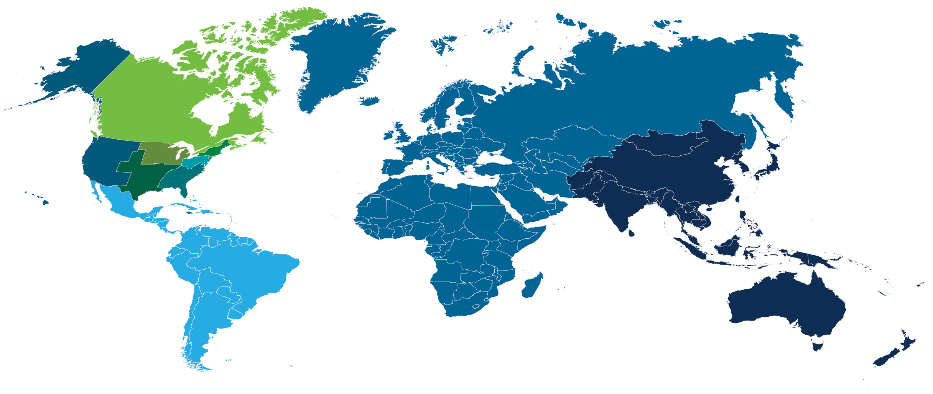
IEEE Membership By Region
Total Membership
+400,000K
across TEN IEEE Regions
IEEE Offices
Notes:
IEEE is GLOBAL!!
Our members live in:
United States
India
China
Pacific Rim
Europe
Middle East
Africa
Canada
Latin America
As I mentioned before, there are 431,000+ worldwide IEEE members in 160+ countries.
IEEE Offices:
Corporate Headquarters – New York City, USA
Operations Centers – Piscataway, NJ, USA
IEEE-USA – Washington, DC, USA
IEEE Computer Society – Los Alamitos, CA, USA
IEEE, Inc. Tax Registration, Brussels, Belgium
Global IEEE Institute for Engineers, India, Bangalore India
IEEE, Inc. Representative Office, Beijing, China
IEEE Beijing Office Extension in Shenzhen, Shenzhen, China
IEEE Tax Registration, Tokyo, Japan
IEEE Asia-Pacific Limited, Singapore
IEEE global presence:
In April, 2016 - opened its second office in Shenzhen, China’s Silicon Valley, due to growth in the country and to better support engineers in that area
In August, 2016 - opened an extension to our offices in Bangalore, India. We can accommodate more that 100 staff members.
IEEE has signed a lease on our new office in Vienna, Austria. We will be co-located with the Austrian Standards Institute.

Slide 16



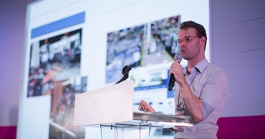



Benefits of Membership
IEEE members stay current in the technology profession, connect with peers, and invest in career advancement.
Access vital technical information and research
Connect to the profession with valuable networking opportunities
Explore education resources and career development tools
Participate in local activities
Receive discounts on IEEE products and other services
Find ways to contribute to the community
Plus, get tailored benefits by joining an IEEE Society.
Learn more: ieee.org/join

Slide 17

Member Resources: Technical Content
Access quality information
IEEE Xplore® Explore research from IEEE journals, magazines, and conference proceedings. ($) | IEEE Learning Network High-quality, peer-reviewed online courses in relevant topics. ($) | Conferences Learn about new topics and trends from leading experts, and network with other professionals. ($)
IEEE Author Center Publish your research in a high-quality publication and help advance your scientific field. ($) (+) | eBook Classics Get over 350 classic eBook titles from the IEEE Press collection. | IEEE Standards Search for published standards and find related products and resources. ($)
IEEE.tv View videos and live broadcasts covering lEEE activities from around the globe. | IEEE Societies and Technical Councils Join specialized groups matched to your technical interests. ($) | IEEE DataPort Access an easily accessible repository of datasets and data analysis tools.
IEEE Spectrum Magazine Stay informed about major trends and developments in technology, engineering, and science. | Proceedings of the IEEE The leading journal for in-depth tutorials and coverage of technical developments. | IEEE Potentials Magazine Explore career strategies and important technical trends geared to young professionals.
$ - Discounted price for IEEE members
+ - Additional fee
Learn more: ieee.org/start

Slide 18

Member Resources: Networking
Explore networking opportunities
Conferences Attend conferences to connect with other like-minded professionals. ($) | IEEE Collabratec® Connect and collaborate with other IEEE members in IEEE's online networking platform. | Volunteering opportunities Get involved in IEEE activities at a local and global level and give back to your profession.
Local meetings and events Meet and socialize with members and volunteers in your Section. | IEEE Societies and Technical Councils Join specialized communities matched by your technical interest. ($) | Women in Engineering (WIE) Become a part of the influencial IEEE member group promoting women engineers and scientists. (+)
Young Professionals Connect with recent graduates interested in expanding their global network, connecting with peers locally, and giving back to their communities.
$ - Discounted price for IEEE members
+ - Additional fee
Learn more: ieee.org/start

Slide 19

Member Resources: Education & Career
Expand your learning and find the right career path
IEEE Credentialing Program Guarantee that your education program offers the relevant content that engineers need to stay ahead in their fields. (+) | IEEE Learning Network (ILN) ILN provides hundreds of hours of educational content from across IEEE on a variety of topics, all in one place. ($) | IEEE Job Site Find job postings by more than 4,000 leading corporations and organizations.
IEEE Mentoring Program An online program that facilitates the matching of IEEE members for the purpose of establishing a mentoring partnership. | IEEE.tv Access on-demand programs on technical topics including conference coverage and live streaming events. | Career webinars Choose from more than 180 archived webinars and download supporting slides and documents where available.
IEEE-USA The career and public policy interest group for IEEE members in the USA providing career tools, resources, and government relations programs. | IEEE Consultants Network Connect to a global consultant’s network by creating a profile or searching for a consultant. (+) | IEEE Innovation at Work Access articles and free virtual events on cutting edge technical topics.
$ - Discounted price for IEEE members
+ - Additional fee
Learn more: ieee.org/start

Slide 20

Member Resources: Local Activities
Find local resources and activities
Through your Region and Section Upon joining, you were assigned to a local IEEE group based on your geographic location. This information can be found in your IEEE Account, in IEEE Collabratec, or on your IEEE membership card. | Access your local volunteers in IEEE Collabratec® Contact IEEE volunteers in your Section to find out about events near you. | Search for local events Use the IEEE event finder to discover meetings and events hosted both locally and globally.
Learn more: ieee.org/start

Slide 21

Member Resources: Discounts
Take advantage of exclusive IEEE Member discounts
Conferences Save up to 50% on conference registration fees ranging from US$300 to US$1,500. ($) | IEEE Xplore articles Save nearly 50% off single article purchases from IEEE Xplore, the largest library of electrical engineering, computer science, and electronics literature. ($) | Wiley Books Receive up to 35% off titles from Wiley-IEEE Press, including bioengineering, power and energy, communication technologies, and other growing areas of research. ($)
IEEE Societies Enjoy reduced pricing and additional fees when joining technical Societies or special interest groups. ($) | Insurance Participate in insurance programs ranging from term life, other life, health plans, professional liability, and auto and home (available in specified geographic areas). ($) | Member Discounts Marketplace Access a changing variety of time-sensitive, exclusive discounts on products and services. ($)
IEEE Product Discounts Get group pricing on highly-rated products and services to support members at home and in their professional lives. ($) | IEEE Learning Network Enjoy discounted pricing on a wide range of relevant courses. ($)
$ - Discounted price for IEEE members
Learn more: ieee.org/start

Slide 22


Member Resources: Contribute to the Community
Give back to the global or local community:
IEEE Foundation Support IEEE programs that improve access to technology, enhance technological literacy and technical education, and the benefit IEEE professional community. | IEEE Smart Village Be a part of the initiative that provides access to electricity, creates opportunity, and improves lives in remote communities around the world. | IEEE SIGHT Join the Special Interest Group on Humanitarian Technology (SIGHT) program, where IEEE volunteers around the globe partner with underserved communities to leverage technology for sustainable development.
EPICS in IEEE Help empower students to work with local service organizations and apply technical knowledge to implement solutions for a community’s unique challenges. | IEEE Eta Kappa Nu The honor society of IEEE, Eta Kappa Nu promotes excellence in the profession and in education with ideals of Scholarship, Character, and Attitude.
Learn more: ieee.org/start

Slide 23

Member Resources: IEEE App
Learn more: app.ieee.org

Slide 24
Communities
Membership
Communities
Conferences
Publications
Standards
Education
Career Resources
Humanitarian and Philanthropic Goals
Awards
Industry
Information sharing is a cornerstone of productive collaboration.
IEEE believes that even small ideas can develop into towering solutions.

Slide 25

Interaction is Key at IEEE
342 Sections in TEN geographic Regions worldwide
Self-organizing communities:
cross- and inter-disciplinary networking via
2,562 Professional Chapters that unite local
members with similar technical interests
39 Technical Societies
More than 107,000 Student members
3,485 Student Branches at colleges and
universities in 100 countries
2,877 Student Branch Chapters of
IEEE Technical Societies
580 affinity groups and growing, including
IEEE Young Professionals (YP), IEEE-USA
Consultant’s Network, IEEE Life Members (LM),
IEEE Entrepreneurship, and IEEE Women in Engineering (WIE)
Data current as of June 2021
Learn more: ieee.org/about/at-a-glance.html
Notes:
The local IEEE sections provide a community of colleagues whose geographic area may range as wide as a single country or a single major city.
Your employees can network globally, or locally, gaining knowledge and contacts that will help your company.
Members build a network through these local Section, Chapter, and Student Branch activities.
335 Sections
2,274 Chapters
2,845 Student Branches
Volunteer leaders also gain management, teamwork and leadership experience by participating in and leading these activities.
In addition to providing local professional and technical activities, they also recognize achievements of members and others.
If needed or desired, have numbers about local cities, countries, regions.

Slide 26

IEEE Societies
IEEE Societies allow members to network with colleagues and collaborate on projects with leading experts—while taking advantage of specialized opportunities.
IEEE Aerospace and Electronic Systems Society (AESS) IEEE Antennas and Propagation Society (APS) IEEE Broadcast Technology Society (BTS) IEEE Circuits and Systems Society (CAS) IEEE Communications Society (ComSoc) IEEE Computational Intelligence Society (CIS) IEEE Computer Society (CS) IEEE Consumer Technology Society (CTSoc) IEEE Control Systems Society (CSS) IEEE Dielectrics and Electrical Insulation Society (DEIS) IEEE Education Society (EdSoc) IEEE Electromagnetic Compatibility Society (EMC-S) IEEE Electron Devices Society (EDS) IEEE Electronics Packaging Society (EPS) | IEEE Engineering in Medicine and Biology Society (EMBS) IEEE Geoscience and Remote Sensing Society (GRSS) IEEE Industrial Electronics Society (IES) IEEE Industry Applications Society (IAS) IEEE Information Theory Society (ITS) IEEE Instrumentation and Measurement Society (IMS) IEEE Intelligent Transportation Systems Society (ITSS) IEEE Magnetics Society IEEE Microwave Theory and Techniques Society (MTT-S) IEEE Nuclear and Plasma Sciences Society (NPSS) IEEE Oceanic Engineering Society (OES) IEEE Photonics Society IEEE Power Electronics Society (PELS) IEEE Power & Energy Society (PES) | IEEE Product Safety Engineering Society (PSES) IEEE Professional Communication Society (PCS) IEEE Reliability Society (RS) IEEE Robotics and Automation Society (RAS) IEEE Signal Processing Society (SPS) IEEE Society on Social Implications of Technology (SSIT) IEEE Solid-State Circuits Society (SSCS) IEEE Systems, Man, and Cybernetics Society (SMC) IEEE Technology and Engineering Management Society (TEMS) IEEE Ultrasonics, Ferroelectrics, and Frequency Control Society (UFFC) IEEE Vehicular Technology Society (VTS)
Learn more: ieee.org/communities/societies

Slide 27

IEEE Technical Councils
Technical Councils are groups of Societies working together in broad areas of technology.
IEEE Technical Councils are usually focused on a single technology area and the opportunities stemming from it.
IEEE Societies collaborate on:
technical meetings
publishing research
promoting educational activities
developing standards
Learn more: ieee.org/communities/societies/about-technical-councils.html
Notes:
There are currently seven Technical Councils:
Biometrics Council
Council on Electronic Design Automation
Nanotechnology Council
Council on RFID
Sensors Council
Council on Superconductivity
Systems Council

Slide 28

















IEEE Future Directions
Fostering partnerships among Societies, Councils, and industry to find the best knowledge, resources, and opportunities in emerging technologies within IEEE.
MATURITY LEVEL
NEW
GRADUATED
Learn more: ieee.org/about/technologies.html

Slide 29

IEEE Collabratec® | Discover, Connect, Collaborate
Network, collaborate, and create with technology experts.
IEEE Collabratec is an online community where technology professionals can:
Meet technology professionals
Join and participate in communities
Embrace career opportunities
Work together in virtual workspaces
Manage your personal library
Discover IEEE events
Learn more: collabratec.ieee.org
Notes:
Networking is a critical value for IEEE – we want to facilitate the flow of ideas and solutions for the tech industry.
The IEEE Collabratec™ online community offers a suite of productivity tools and is available to technology professionals around the world with exclusive features for IEEE members. Sign up is free for everyone. Research, network, and create—all while saving time.

Slide 30


IEEE Entrepreneurship
The engineering-driven startup community within IEEE.
The IEEE Entrepreneurship community is at the forefront of turning ideas into successful businesses. There are three main ways to get involved:
The IEEE Collabratec® Entrepreneurship Community
brings together individuals who have a passion for all things entrepreneurial.
IEEE Entrepreneurship Events
are designed to inspire tech
startup founders, investors, and service providers.
IEEE Entrepreneurship Portal
is your online resource for growing your ideas and finding IEEE activity relevant to startup companies and founders.
Learn more: entrepreneurship.ieee.org
Notes:
At IEEE, we believe technology entrepreneurs are the key drivers of tomorrow’s innovations and are integral to advancing technology for humanity.
As an association with over 400,000 members worldwide, we seek to foster the entrepreneurship spirit by:
Providing an inspirational medium in which individuals are able to discuss and develop their ideas,
Accessing resources to help bring concepts to life,
Facilitating connections that lead to successful partnerships.

Slide 31







IEEE Innovation Nation
For every idea that needs a platform to showcase its worth,
IEEE Innovation Nation is the competition for it.
Lack of guidance or finances should never be the reason to shut down the entrepreneur inside you. IEEE Innovation Nation is organized to address this by providing resources to take your idea or product to the next level:
TRAINING
Get equipped with necessary skills to run a company
MENTORING
Get guidance from experts in the field
FINANCES
Back your ideas and execution skills with finances
The IEEE Innovation Nation initiative will be carried out in the following areas this year:
Learn more: in.ieee.org
Notes:
Disparity between resource distribution has seen entrepreneurs in countries with a low GDP getting less opportunities.
Not every country has a Silicon-Valley. Lack of guidance or finances should never be the reason to shut down the entrepreneur inside you.
IEEE Innovation Nation is organized to address this by providing you with guidance, mentorship and finances to take your idea or product to the next level.

Slide 32
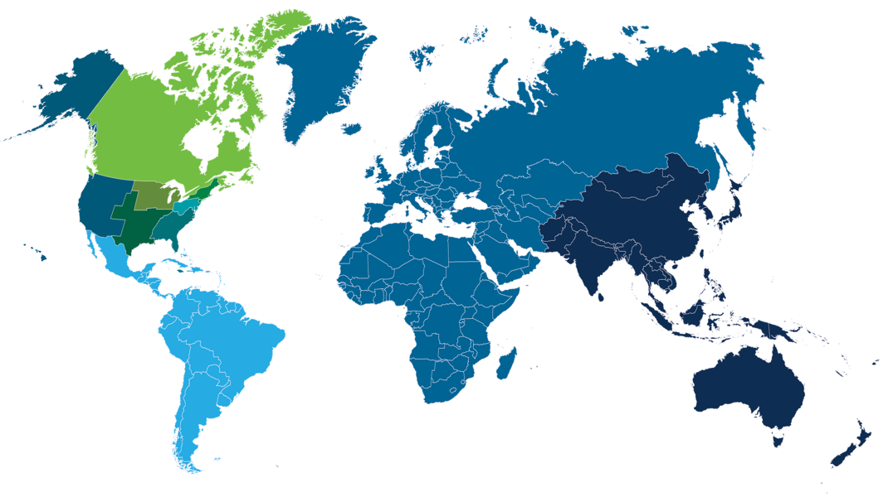
Local Communities
IEEE is divided into ten worldwide geographic regions—local communities are key to making it all come together.
Total Membership +400,000 across TEN IEEE Regions
Within the regions, there are local sections, chapters, and affinity groups
Local communities conduct over 10,000 meetings a year
Provide unique opportunities for members to:
  Attend technical presentations
  Create strong peer-to-peer connections
  Explore their technical interests as a community
  Network locally and globally
  Participate in leadership opportunities
IEEE Offices
Learn more: ieee.org/communities

Slide 33

Student Branches
IEEE Student branches are at the core of student membership, providing:
Networking opportunities in students’ areas of interest and future professions
Learning and social experiences
Collaboration opportunities with
IEEE colleagues and member groups
Spotlight on IEEE University Partnership Program
Collaborative community at the top technical schools in the U.S., China, and India.
Supports activities that challenge students to develop leadership, teamwork, networking, research, and communication skills while learning firsthand how the IEEE serves its members, profession, communities, and humanity worldwide.
Learn more: students.ieee.org

Slide 34
Conferences
Membership
Communities
Conferences
Publications
Standards
Education
Career Resources
Humanitarian and Philanthropic Goals
Awards
Industry
IEEE creates collaborative platforms for tomorrow’s innovators and authors. Because innovation begins with a big idea and IEEE.

Slide 35

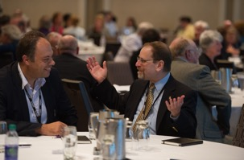
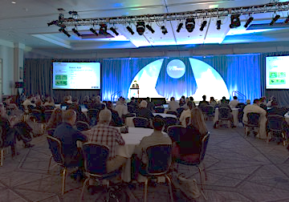
IEEE Conferences
Building relationships and exploring ideas are on the agenda at every IEEE conference.
IEEE sponsors more than 1,600 annual technical conferences around the world.
  In 2020, IEEE published over 205,000 conference papers.
  IEEE partners with over 1,300 institutions around the world each year to bring research forward.
Offers professional expertise in virtual and hybrid formats as well as the traditional face-to-face formats
Provides many resources for authors, speakers, conference organizers, students, and volunteers.
Learn more: ieee.org/conferences/

Slide 36
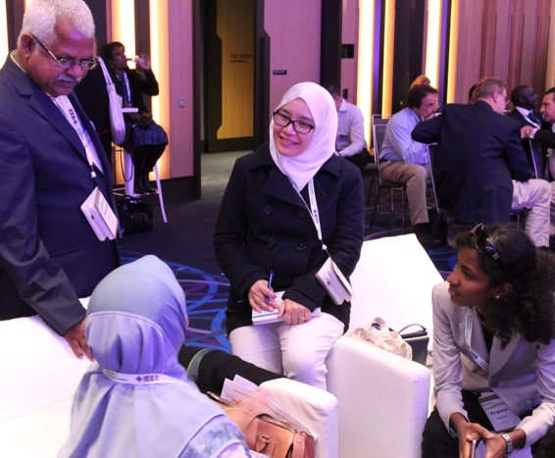
Popular Conferences
When an idea sparks, technology professionals turn to the IEEE community
as a forum and testing ground.
IEEE PES T&D Conference & Exposition (PES T&D)
International Microwave Symposium (IMS)
Supercomputing – International Conference for High Performance Computing, Networking, Storage, and Analysis (SC)
IEEE International Conference on Blockchain and Cryptocurrency (ICBC)
International Conference on Artificial Intelligence and Big Data (ICAIBD)
Global Internet of Things Summit (GloTS)
IEEE International Conference on Cyber Security and Cloud Computing (CSCloud)
IEEE International Conference on Robotics and Automation (ICRA)
IEEE EUROCON - International Conference on Smart Technologies
IEEE AFRICON
World Symposium on Artificial Intelligence (WSAI)
Learn more: ieee.org/conferences/

Slide 37


Conference Proceedings
IEEE produces cutting-edge conference proceedings that are recognized by academia and industry worldwide.
IEEE provides a forum for authors and speakers to present their work at various annual conferences worldwide.
Papers submitted for publication are peer reviewed before they are published, ensuring a high-quality final product.
All papers are published in IEEE Xplore® digital library, usually six weeks after the conference.
Call for papers
IEEE continuously updates its database with opportunities to submit abstracts and papers.
Learn more: ieee.org/conferences/

Slide 38
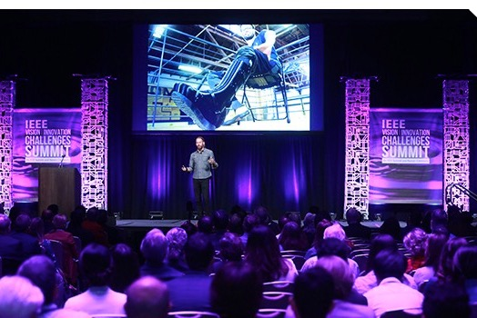

IEEE Meetings, Conferences & Events (MCE)
Find everything you need to know about organizing an IEEE event.
IEEE provides resources and support for the conference community, IEEE volunteers, and conference sponsors:
Conference planning basics
COVID-19 pandemic event resources
Virtual and hybrid event guidance
IEEE sponsorship
IEEE Conference Application
Finance & contracts
Technical program development
Audience development
Tools & resource finder
Learn more: ieeemce.org

Slide 39




Virtual Events Team
The IEEE MCE team has expertise in online, virtual, and digital event mediums.
Virtual Event Series
Digital Event Production
Event Consultation
Hybrid Production
Designing programs for the online experience
Audience engagement: techniques and practices
Keynote prep/Green Room management
Exhibitor/Sponsor innovations and management
Live-day event production
On-demand/hybrid productions
Live sessions, panel discussions, and moderation
Moderated chat and live Q&A with audience
Innovations in program, exhibit, and sponsor design
Consultation in digital platform and services
Tricks and tips for networking and engagement
Collaboration with event organizers
Hybrid program development for a seamless audience experience
Filmed, produced, and edited assets
Highlight videos
Sizzles and interviews
“Virtual events allow us to break through the constraints of time and place to enrich and extend a live gathering”
Marie Hunter, Senior Director, MCE
Learn more: ieee.org/conferences/

Slide 40

Local Meetings and Events
IEEE provides its members and volunteers with year-round networking opportunities.
Local meetings and events are hosted by:
IEEE Sections
IEEE Chapters
Student branches
Other regional governing bodies
Learn more: meetings.vtools.ieee.org/events/search

Slide 41
Publications
Membership
Communities
Conferences
Publications
Standards
Education
Career Resources
Humanitarian and Philanthropic Goals
Awards
Industry
IEEE research advances technical theory that the world puts into practice.
People expect technology to solve tomorrow’s problems. So does IEEE.

Slide 42

IEEE Publications
The technology landscape is constantly evolving—stay current on the latest breakthroughs with IEEE.
IEEE’s publications provide coverage of the latest technical developments that shape the world.
  Each year, IEEE introduces new publications to address growing areas of research, such as cloud computing, renewable energy, cognitive computing, 5G, sustainable computing, autonomous vehicles, and more.
IEEE gives authors flexibility with open access and hybrid journals
1 million+ articles from 200 Journal and Magazine titles
3.6 million+ Conference papers
1,200 New and revised Standards
5,000+ eBooks titles
1,000+ eLearning titles
PLUS, NEW TOOLS TO DISCOVER THEM ALL
Learn more: ieee.org/publications
Notes:
With IEEE Xplore, engineers are relying on the most-cited research, with titles on the cutting-edge of technology.
Your company can be sure that the research is reliable, saving you time and money by bringing products to market sooner.
Mention trend papers
Trend papers targeted at industry
IEEE is always looking forward!
Smart Cities, 5G draft documents

Slide 43






Why IEEE?
Quality makes an impact—the top-cited publications in the field for IEEE
IEEE Publishes:
20 of the top 25 journals in Electrical and Electronic Engineering
9 of the top 10 journals in Telecommunications
Top 5 journals in Automation & Control Systems
8 of the top 10 journals in Computer Science—Artificial Intelligence
4 of the top 5 journals in Computer Science—Hardware & Architecture
3 of the top 5 journals in Computer Science—Information Systems
Top 3 journals in Computer Science—Cybernetics
3 of the top 5 journals in Computer Science—Software Engineering
IEEE Journals are:
#1 in Automation and Control, Computer Science—Artificial Intelligence, Computer Science—Hardware & Architecture, Computer Science—Cybernetics, Computer Science—Information Systems, Computer Science—Software Engineering, Industrial Engineering, and Telecommunications
The Journal Citation Reports from Clarivate Analytics presents quantifiable statistical data that provides a systematic, objective way to evaluate the world’s leading journals. Based on the 2019 study released June 2020.
Learn more: ieee.org/citations
Notes:
Each year, the Journal Citation Reports® (JCR), published by Clarivate Analytics (formerly Thomson Reuters), examines the impact of academic journals by determining how often journal articles are cited by later research.
The 2015 study, released in June 2016, shows that IEEE publications continually rank at the top in citations on technology.
Why is it important? Because engineers need the best research. Most-cited is a main factor in determining the best. Its what your industry relies on.

Slide 44


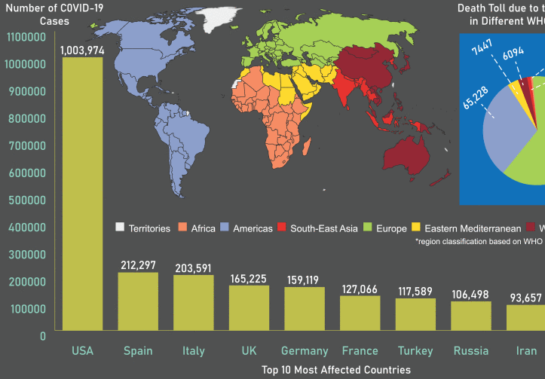

IEEE Xplore® Digital Library
IEEE Xplore is your gateway to trusted research—journals, conference proceedings, standards, eBooks, and education courses—to help you fuel imagination, build from previous research, and inspire new ideas.
Powerful search tools
User-friendly interface
More than 5 million full-text documents
Users download more than 15 million documents per month
Learn more: ieeexplore.ieee.org
Notes:
The IEEE Xplore is a powerful resource for discovery of and access to scientific and technical content published by the IEEE and its publishing partners.
This is where IEEE information lives.
Research Options for Every Organization
Each company or organization is unique. That's why we have developed research subscription options to fit any size company and budget. Whether you are developing technology and products for growth or sharpening your competitive edge through innovation, the IEEE Xplore digital library has a subscription option to meet your organization’s needs.

Slide 45
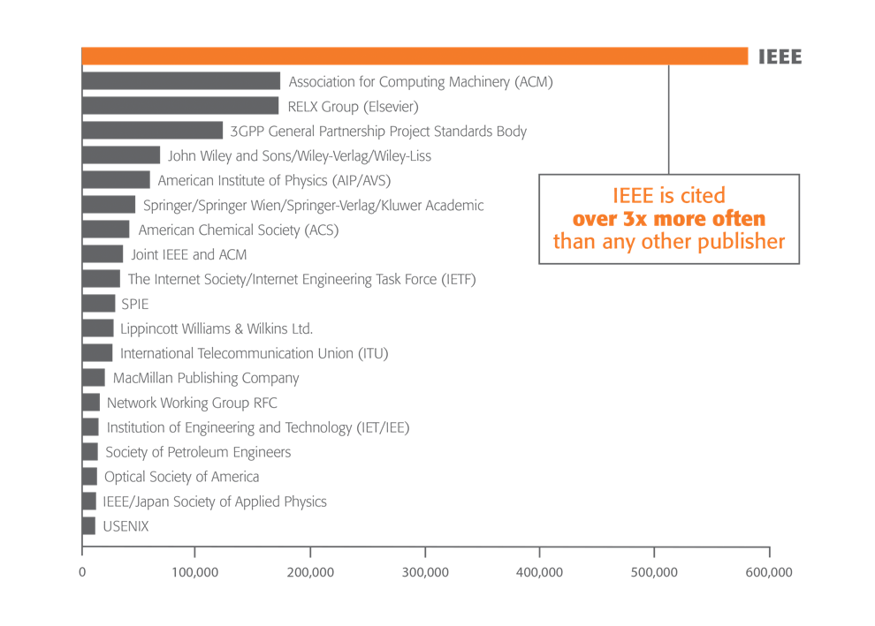


IEEE Research Powers New Patents
IEEE is the most-cited publisher in new patents from top patenting organizations.
A study of the top 40 patenting organizations ranks IEEE #1 again
Over 3x more citations than any other publisher
Patent referencing to IEEE increased 896% since 1997
The importance of sci-tech literature in patents is rising
IEEE research is increasingly valuable to innovators
1790 Analytics LLC performed an in-depth analysis of the science references from top patenting firms.
Learn more: ieee.org/publications/subscriptions/patent-citation/
Notes:
IEEE publications are a driving force behind today’s new patents
IEEE leads as the most-cited publisher in new patents from the top patenting organizations
References to IEEE papers have increased 846% since 1997
Individual benefit – With IEEE Xplore, engineers are relying on the most-cited, trusted research. So they can get it right, the first time.
Company benefit – Your company can be sure that the research is reliable.

Slide 46

Improve ROI with Smarter Research
Organizations receive measurable returns on investments when their researchers use the IEEE Xplore digital library.
IEEE Xplore initiates a cycle of interrelated process improvements, product innovations, and business savings.
Increases daily
productivity
Encourages
innovative
thinking
Saves time
for other job
functions
Benefits from
using IEEE Xplore
Improves
processes and
development
More efficient problem solving
Learn more: innovate.ieee.org/improve-roi-through-smarter-research-with-the-ieee-xplore-digital-library/
Notes:
Organizations receive measurable returns on their investment when their researchers use the IEEE Xplore® digital library.
IEEE Xplore:
Increases daily productivity
Saves time for other job functions
More efficient problem solving
Increases processes and development
Encourages innovative thinking
What does it mean for you?
If an engineer saves time, your organization saves money. IEEE Xplore makes it possible.

Slide 47
Improve ROI: Benefits of using IEEE Xplore
Keep Up-to-Date & Accelerate Research
IEEE Xplore allows for smarter, more efficient research projects.
Stay
Up-To-Date
Avoid
reinventing
the wheel
Increased
Productivity
TOP THREE USER BENEFITS OF IEEE Xplore:
Accelerate R&D to Increase ROI
There are many business advantages of using IEEE Xplore.
Encourage
Innovative
Thinking
Increased
Productivity
Save Time
and Money
TOP THREE MANAGEMENT BENEFITS OF IEEE Xplore:
Lost time affects your bottom line
The faster you can successfully complete your research, development, and testing—and get your products to market, the higher your ROI will be.
Learn more: innovate.ieee.org/improve-roi-through-smarter-research-with-the-ieee-xplore-digital-library/
Notes:
Top three user benefits of IEEE Xplore (User = individual engineer)
74% Stay Up-To-Date
55% Avoid reinventing the wheel
55% Increased Productivity
Top three management benefits of IEEE Xplore (Management = company)
60% Save Time and Money
60% Encourage Innovative Thinking
80% Increased Productivity
Lost time affects your bottom line
Your bottom line is affected each day an engineer tries to work through a problem without the right resources.
Less time spent during the research phase of a project significantly improves ROI.
Two-thirds of survey respondents say that IEEE Xplore greatly reduces research time
Many respondents indicate that it cuts their research or project time in half.
Time plays a key role in productivity

Slide 48

Why Publish with IEEE?
Authors publish with IEEE for the heightened visibility,
research activity, and industry credibility.
OPTIMIZED VISIBILITY Fifteen million downloads each month from the IEEE Xplore® digital library provides authors with the “findability” they seek. | IEEE REPUTATION Each author can take advantage of IEEE’s stellar reputation. Past and present members include nearly two dozen Nobel Prize-winning innovators. | TRUSTED CONTENT IEEE journals and conference proceedings receive nearly three times the patent citations of competing publishers.
OPPORTUNITIES TO PUBLISH Over 200 journals, transactions, magazines, and more than 1,600 conferences around the world allow authors to publish in the best forum for their work. | STREAMLINED PUBLICATION IEEE’s web-based workflow, including electronic submission, has shortened the time from submission to IEEE publication and helps authors track a paper’s progress. | EDITORIAL DEVELOPMENT Tools are available to help manage your workflow and make it easier to collaborate, reference, publish, and deliver your writing to readers and researchers.
PEER REVIEW The peer-review process is designed to ensure the high quality of every article submitted to and published by IEEE | REFERENCING AND SEARCHING IEEE Xplore articles include outbound reference links to other publisher content registered in the CrossRef system. IEEE Xplore is also indexed by Google™. | IEEE AUTHOR CENTER Find tools and resources to support your scholarly publishing efforts
Learn more: ieeeauthorcenter.ieee.org

Slide 49
Standards
Membership
Communities
Conferences
Publications
Standards
Education
Career Resources
Humanitarian and Philanthropic Goals
Awards
Industry
IEEE is one of the leading producers of standards in the world,
and we work hard to ensure comprehensive and global standards.

Slide 50






IEEE Standards Association (IEEE SA)
IEEE nurtures, develops, and advances the building of global technologies.
Consumers around the world enjoy the benefits of IEEE Standards:
Provide the bricks and mortar
for a globally level playing field
for innovation
Protect public safety,
health & wellbeing
Contribute to a
sustainable future
COMPETITION
Influencing the competitiveness of industries & companies
CONFIDENCE
Demonstrating quality to customers by meeting expectations & requirements
Global
IEEE
Standards
INNOVATION
Providing an essential platform on which new technologies & processes can build
GROWTH
Facilitating trade & economic growth
PERFORMANCE
Fine-tuning performance and improving efficiency
SUSTAINABILITY
Making technology safer, interoperable and sustainable for the future
50
50

Slide 51

IEEE Standards Association
IEEE Standards drive the functionality, capability, and interoperability of a range of products and services that affect the way people live, work, and communicate.
INDIVIDUAL MEMBERSHIP
Maintaining
the Standard
Initiating the
Project
7500 + individual members in 94 countries
CORPORATE MEMBERSHIPS
  380+ member corporations in 25 countries
Gaining Final
Approval
Mobilizing
the Working Group
STANDARDS & RELATED ACTIVITIES
  34,000+ global participants;
  all interested parties are welcome
  1,900+ Standards & Projects
Balloting the
Standard
Drafting the
Standard
GLOBAL AGREEMENTS
  180+ Global agreements
Learn more: standards.ieee.org
Notes:
We work with the entire tech community to make sure IEEE standards are the right standards—for everyone.
Individual benefit – If engineers are working with the latest IEEE standard, they can ensure compliance from the start
Company benefit – saves time and money
The Life of a IEEE Standard
Initiating the Project –
Standards projects are started when there is a need for an idea or concept to be standardized. The idea or concept can be broad or very specific. However, no standard is developed by one person alone; ultimately group collaboration and consensus is required.
Mobilizing the Working Group –
Working Groups work to create and write the standard. Working Groups are open to anyone to participate. For individual standards projects, IEEE or IEEE-SA membership is not required to participate. For corporate standards projects, IEEE-SA corporate membership is required. Overall, Working Groups strive for broad representation of all interested parties and encourage global participation.
Drafting the Standard
The first milestone for many Working Groups is finishing their first complete draft. The scope and purpose should be kept in mind at all times, since this will be what the IEEE-SA Standards Board will be evaluating the document against. The technical editor will then compile the work of the Working Group into one document.
Balloting the Standard
Balloting begins when the Sponsor decides the draft of the full standard is stable. The Sponsor forms a balloting group containing persons interested in the standard. While anyone can contribute comments, the only votes that count toward approval are those of the eligible members of the balloting group.
Gaining Final Approval
The IEEE-SA Standards Board approves or disapproves standards based on the recommendation of its Standards Review Committee (RevCom). This committee makes sure working groups follow all procedures and guiding principles in drafting and balloting a standard. After approval, the standard is edited by an IEEE-SA editor, given a final review by the members of the working group, and published.
A standard is valid for ten years from its approval date.
Maintaining the Standard
Sometimes a standard may need a technical or editorial correction to be made.
As part of the standards development process, IEEE can easily accommodate this by issuing a corrigenda or errata Sheet.
Corrigenda correct a technical error, as well as a semantic error and require a PAR and to go through a consensus ballot.

Slide 52


IEEE Standards in Real Life
Enabling consumer connectivity through consensus building
ELECTRIC VEHICLE STANDARDS
IEEE 802™ Series
IEEE 1901™
IEEE 1901.2™
IEEE 1609™ Series (Vehicular Communications)
IEEE 2030™
IEEE 2030.1.1™
IEEE 2030.5™
IEEE P2040™ Series
IEEE P2408.11™
SMART GRID INTO HOME DEVICES STANDARDS
IEEE 1547™ Series (Distributed Energy Interconnection Solar, Wind, Storage, etc.)
IEEE 2030™
SMART GRID INTO HOME DEVICES STANDARDS
IEEE 1675™
IEEE 1775™
IEEE 2030™
IEEE 2030.1™
IEEE 1901™
IEEE 1901.2™
SMART METERING STANDARDS
IEEE 1377™
IEEE 1701™
IEEE 1702™
IEEE 1703™
IEEE P1704™
HOME NETWORKING STANDARDS
IEEE 802™
IEEE P1901™
IEEE 1901.2™
IEEE 1905.1™ (Communication inside the home)
MOBILE VIDEO STANDARDS
IEEE 2200™
IEEE 802.11™ (Intelligently Cached Mobile Content)
IEEE 1858™ (Camera Quality)
IEEE P2048.2™
IEEE P2048.3™
IEEE PW048.12™
3D VIDEO STANDARDS
IEEE 1857.9™
IEEE P2048.2™
IEEE P2048.3™
IEEE P2048.12™
IEEE P3141™
HOME NETWORKING STANDARDS
IEEE 802™
IEEE P1901™
IEEE 1901.2™
IEEE 1815™
Learn more: standards.ieee.org
Notes:
These are some examples of how IEEE Standards make the world safer and more connected.

Slide 53



IEEE Standards in Real Life
Expanding the adoption of wearable devices through IoT and consensus building
SMART EYEWEAR
IEEE 802.11™
IEEE 802.15.4™
IEEE P2048™
MOBILE DEVICES
IEEE 802.11™
IEEE 802.15.4™
IEEE 802.15.6™
IEEE 2200™
IEEE 11073-20601™
IEEE P2721™
SMART WATCH
IEEE 802.11™
IEEE 802.15.4™
IEEE 802.15.6™
IEEE 2700™
IEEE 11073-20601™
NETWORK, WEARABLE DEVICES AND IoT INFASTRUCTURE
IEEE 802®
IEEE 1451™ Series
IEEE 1588™
IEEE P360™
IEEE P1912™
IEEE 2413™
IEEE 2050™
IEEE P2144 Series
IEEE PS786™
SMART INSOLES
IEEE 802.11™
IEEE 802.15.4™
IEEE 802.15.6™
IEEE 1451™ Series
IEEE 2700™
WIRELESS CONNECTIVITY
IEEE 802.11™
IEEE 802.15.4™
CLOUD COMPUTING
IEEE P2301™
IEEE PS302™
HUMAN AUGMENTATION
IEEE P2049™
VIRTUAL REALITY & AUGMENTED REALITY
IEEE P1589™
IEEE P2048™Series
IEEE P3141™
SMART FABRIC
IEEE 802.15.4™
IEEE 1451™ Series
IEEE 2700™
IEEE P2786™
ACCESSIBILITY
IEEE PS049™ Series
IEEE P2843™
Learn more: standards.ieee.org
Notes:
These are some examples of how IEEE Standards make the world safer and more connected.

Slide 54
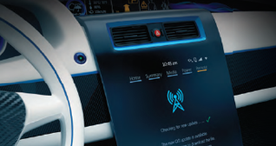
IEEE Standards in Real Life
Advancing the technologies for connected vehicles through consensus building
INTELLIGENT TRANSPORTATION SYSTEMS
IEEE 1609™
A family of standards defining the architecture, services and standard interfaces for secure vehicle-to-vehicle (V2V) and vehicle-to-infrastructure (V2I) wireless communications.
IEEE 1616™
Standards for motor vehicle event data recorders.
IEEE 802.11™
WLAN to support communication between vehicles and the roadside and between vehicles while operating at speeds up to a maximum of
200 km/h for communication ranges up to
1000 meters.
IEEE P2020™
IEEE P2040™Series
CONNECTIVITY
IEEE 802.3™
Defining the physical layer and data link layer’s media access control of wired Ethernet, in local area networks and wide area network applications.
IEEE 802.1 TSN™
IEEE 2030.5™
TRANSPORTATION ELECTRIFICATION
IEEE 2030™ and its related standards are the first all-encompassing standards series providing alternative approaches and best practices for achieving smart grid interoperability.
IEEE 1547™ SERIES: A series of standards for distributed power to maximize the benefits of interconnection.
IEEE P1562™: Standard for array and battery sizing.
IEEE 1901™ SERIES : Standards relating to broadband connectivity over electric power lines.
VISION SYSTEMS
IEEE 2020™
TRAFFIC SAFETY
IEEE 1512™
Multiple standards for traffic safety, hazardous materials and public safety incident communications.
IEEE P2040™ SERIES
IEEE P2048.11™
CYBERSECURITY
IEEE 203.5™
COOPERATIVE, AUTONOMOUS AND AUTOMATED DRIVING
IEEE P2040™ SERIES
A series of standards for connected, automated and intelligent vehicles.
IEEE P7002™
IEEE P7009™
IEEE P2048.11™
SMART RAIL
A wide range of standards relating to electric rail operation including IEEE 11-2000, IEEE 16-2004, IEEE 1653.1, IEEE 1791, P1883, P1884, P1887, IEEE 1896, P2046, 1536, 1558, 1568, 1570, 1628, 1629, 1630, 1653 SERIES, AND 1698. As well as a series
of standards relating to communication for
rail transit systems, including IEEE 1473,
1474, 1475, 1476, 1477, 1482.1, AND 1483.
DESIGN AUTOMATION
IEEE 2846™
IEEE 2851™
Learn more: standards.ieee.org
Notes:
These are some examples of how IEEE Standards make the world safer and more connected.

Slide 55



IEEE Standards in Real Life
Improving personal health device communications through consensus building
GLUCOSE METER
IEEE P11073-10417™
CARDIOVASCULAR FITNESS & ACTIVITY MONITOR
IEEE 11073-10441™
PULSE OXIMETER
IEEE P11073-10404™
INSULIN PUMP
IEEE 11073-10419™
ELECTROCARIOGRAPH (ECG)
IEEE 11073-10406™
WEIGH SCALE
IEEE 11073-10415™
CONTINUOUS GLUCOSE MONITORING
IEEE P11073-10425™
CONNECTIVITY TRANSPORTS
IEEE 802.11™ (Often referred to as WiFi®)
IEEE 802.15.4™ (Often referred to as Zigbee®)
IEEE 11073-30300™ (Often referred to as Infrared Communications)
IEEE 11073-30400™ Near Field Communications
IEEE 802.3™ (Often referred to as Ethernet)
IEEE P271™ Wireless Diabetes Device Security Assurance
SLEEP APNEA BREATHING THERAPY EQUIPMENT
IEEE 11073-10424™
BLOOD PRESSURE MONITOR
IEEE 11073-10407™
CLOUD
IEEE 2301™
IEEE P2302™
BODY COMPOSITION ANALYZER
IEEE 11073-10420™
Learn more: standards.ieee.org
Notes:
These are some examples of how IEEE Standards make the world safer and more connected.

Slide 56
Participate in Standards Development
Getting involved in IEEE standards provides many benefits:
Opportunities to network with industry peers
Broaden your understanding of your industry and technology
Gain familiarity with the content of standards in which you are involved
Facilitate early compliance and anticipating market requirements
WAYS TO GET INVOLVED
Standards Development
Industry Connections Program activities
LEARN ABOUT:
  IEEE SA PRACTICES
  IEEE SA OPEN - Open Source
  IEEE Conformity Assessment Program
  IEEE Alliance Management Services
  IEEE SA Global Engagement activities
Learn more: standards.ieee.org

Slide 57







IEEE SA Practices
Addressing global problems through community and consensus.
Health & Life Sciences
• Pharma
• Clinical health
• Wellness
New Frontiers
• Sustainability
• Cybersecurity
• Emerging technology areas
Mobility
• Safe autonomous driving
• Zero emissions
• MaaS
Foundational Technologies
• Industrial IoT
• Consumer technology
• Infrastructure
Application Technologies
Energy
• Smart energy
• Energy efficiency
• Energy infrastructure
Telecommunications & Connectivity
• Rural
• Next generation telecom
• Wired and hybrid
communications
57
11
Notes:
Practices can be thought of as Centers of Excellence. They each have:
Focus Areas (Workstreams)
Thought leadership
Industry experts/connections to industry
Paths to the full SA standards ecosystem
Access to trusted resources
They gather, connect and promote diverse ideas, innovation and expertise to respond to challenges and accelerate impact.
Aims/goals
Focused on delivering solutions to large scale challenges by addressing gaps
Positively impacting the technology landscape by convening experts, innovators, and motivated professionals [for practical solutions]
Working to make a difference by accelerating industry adoption through incubation and collaboration
Serving as a neutral resource
Collaborative information sharing in an open, transparent, inclusive environment

Slide 58









IEEE SA Program Portfolio
Industry Connections
Exploring & incubating
new tech & its use
Open Source
Providing a community-powered platform to support open source projects
Standardization
Creating markets & protecting public
safety through standards development
Alliance Management
Providing program support to alliances & trade associations
Membership
Getting connected to experts & resources & enabling advanced participation options
Registries
Providing unique identifiers to support global compatibility & interoperability
Industry Affiliate Network
Assisting industry organizations in accelerating development and adoption of global standards
Conformity Assessment
Providing confidence & assurance
& accelerating market adoption
58

Slide 59
Education
Membership
Communities
Conferences
Publications
Standards
Education
Career Resources
Humanitarian and Philanthropic Goals
Awards
Industry
IEEE inspires young minds, enables futures, and discovers solutions to tomorrow’s challenges.

Slide 60
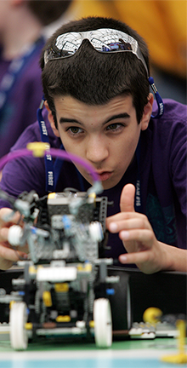
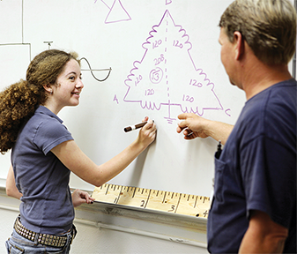

IEEE Educational Programs and Resources
IEEE programs open eyes to possibilities.
Enabling students and professionals to achieve
their goals with:
Continuing Education
Pre-University STEM Programs
University Programs
Career Preparation
Volunteer Mentoring Opportunities
Awards and Scholarships
Visit ieee.org/education
Notes:
EEE also provides ample educations and learning resources—spanning from STEM programs for young learners (elementary through high-school) to university programs and career preparation and even volunteer mentoring opportunities.
The goal of these programs is to ensure the growth of skill and knowledge among professionals and to foster individual commitment to continuing education among IEEE members, the engineering and scientific community, and the general public.
The IEEE TryEngineering Volunteer STEM Portal is a free website for IEEE volunteers to share their pre-university STEM programs, that can also serve as a resource for other IEEE volunteers interested in teaching STEM.

Slide 61





Continuing Education: IEEE Learning Network
IEEE courses are taught by experts in technology–expand your skill set with the latest education courses.
Advance Your Career
Learners who pass the course assessments through the IEEE Learning Network can earn CEUs and PDHs.
High-Quality Education
Courses are developed and peer-reviewed by leading experts in the field.
Interactive Content
With an easy-to-use player/viewer, audio and video files, diagrams, animations, and automatic place marking.
Self-paced & Flexible
Online learning modules ranging from one to three hours in length.
See full list of courses and try free courses: iln.ieee.org

Slide 62


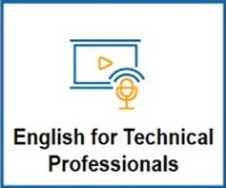



Continuing Education: IEEE Learning Network
IEEE keeps up with the rapid pace of technology, continuously adding new courses.
Cloud Computing
(190 courses)
Software Engineering
(664 courses)
Ethical Hacking
(63 courses)
Cyber Security
(156 courses)
5G Technology
(715 courses)
Smart Grid
(348 courses)
3D Printing
(673 courses)
Vehicle Technology
(577 courses)
See full list of courses and try free courses: iln.ieee.org

Slide 63

Continuing Education: IEEE Society Resource Center
Access to technical content, training, and education for every engineering discipline.
Valuable IEEE Society and technical community content
Access to content 24/7 through an easy-to-use global portal
Peer-reviewed technical products available
Opportunities to earn CEUs and PDHs
Most technical content available at no cost for Society members from their respective Resource Center
See the full list of IEEE Society Resource Centers: ieee.org/communities/ieee-resource-centers.html

Slide 64

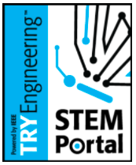


Pre-University STEM Education Resources
IEEE offers STEM education opportunities for pre-university students and teachers across the globe.
TryEngineering.org: Free STEM education content, including lesson plans for teachers, online engineering games, engineer profiles, an accredited engineering program university finder, and much more.
Volunteer STEM Portal: A free website for IEEE volunteers to share their pre-university STEM programs. The portal also serves as a resource for other IEEE Volunteers interested in teaching STEM.
TryEngineering Together: A virtual mentoring program that pairs engineers and STEM enthusiasts with students in grades 3–8 in under-resourced school districts.
TryEngineering Summer Institute: A two-week, on-campus summer engineering experience for high school students.
IEEE REACH: Provides STEM and Social Studies teachers with free resources that, through the lens of history, situate science, technology, and engineering in their social and humanistic contexts. Resources include lesson plans, hands-on activities, primary source materials, and student videos that deliver a new, interdisciplinary pathway for STEM education.
Visit ieee.org/education

Slide 65

University Education Resources
IEEE is ensuring that students have the resources needed to succeed academically, and faculty members have opportunities for career development.
ABET Accreditation: IEEE and its volunteers have a voice in determining the threshold set of knowledge, skills, and abilities needed for successful entry into engineering, computing, and technology fields.
EPICS in IEEE: Students learn to solve problems in communities worldwide through service learning, while at the same time improving the quality of life for the people living there.
IEEE Eta Kappa Nu (IEEE-HKN): Encourages and recognizes individual excellence in education and meritorious work, in professional practice, and in any of the areas within the IEEE-designated fields of interest.
IEEE Teaching Excellent Hub: Provides professional development resources for those teaching engineering, computing, and technology at the university level.
IEEE Education Society: The IEEE Education Society is a worldwide community of professionals dedicated to ensuring high-quality education in science and engineering.
Visit ieee.org/education

Slide 66
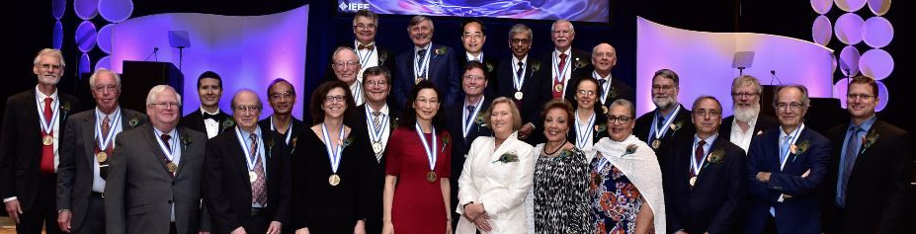
IEEE Educational Activities Board (EAB) Awards
Recognizing and honoring major contributions to engineering and technical education.
Core IEEE EAB Awards:
Meritorious Achievement in Accreditation Activities
Meritorious Achievement in Continuing Education
Meritorious Achievement in Outreach and Informal Education
Meritorious Achievement Award in Pre-University Education
Major Education Innovation
Meritorious Service to IEEE EAB
Educational Activities Board (EAB)/Standards Association (SA) Board of Governors Standards Education Award
Employer Professional Development
Section Professional Development
Society/Council Professional Development
Scholarship/Fellowship
IEEE Life Members Graduate Study Fellowship in Electrical Engineering
The Charles LeGeyt Fortescue Scholarship
IEEE-HKN Awards and Recognitions:
Outstanding Chapter Award
Alton B. Zerby and Carl T. Koerner Outstanding Student Award
Outstanding Young Professional Award
C. Holmes MacDonald Outstanding Teaching Award
Eminent Member Recognition
Distinguished Service Award
Asad M. Madni Outstanding Technical Achievement and Excellence Award
Learn more: ieee.org/education/awards/index.html

Slide 67
Career Resources
Membership
Communities
Conferences
Publications
Standards
Education
Career Resources
Humanitarian and Philanthropic Goals
Awards
Industry
IEEE offers lots of ways to build and plan your career.

Slide 68

IEEE Credentialing Program
Turn meetings into educational experiences.
IEEE Credentialing Program will help your technical professionals: Gain a competitive advantage Update their knowledge and skills Build professional credibility Earn the CEUs/PDHs they need to keep their licenses current | Participants and attendees of IEEE sponsored events can earn: Continuing Education Units (CEU) Professional Development Hours(PDH) Certificates of Participation Digital Badges Recognition for their time and hard work | IEEE Credentialing Program provides credentials for offerings such as: Tutorials, technical programs, short courses, and workshops Sponsored lectures and short courses Classroom Lectures Seminars Laboratories Study networks Continuing education through the IEEE Learning Network And more
Learn more: ieee.org/education/certificates

Slide 69

IEEE Job Site
Find Engineering and Technical Jobs, plus so much more.
Job Seekers
Search for jobs or browse by category
Get relevant career news and advice
Know what to ask for with the
IEEE-USA Salary Calculator
Employers
Recruit highly qualified, sought-after IEEE member candidates
Search the IEEE resume database of registered job seekers to find the right candidate
Learn more: jobs.ieee.org

Slide 70

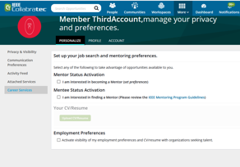
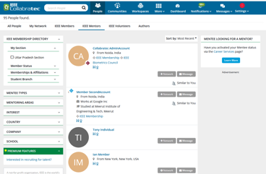
IEEE Mentoring Program
Online program that facilitates the matching of IEEE members for a mentoring partnership.
Benefits of participating in the IEEE mentoring program:
Brings ongoing attention to your career development
Let’s you develop a specific skillset
Expands your professional network
Provides an opportunity to share knowledge and experiences
Allows participants to see things from another person's perspective
Enhances your personal brand
Learn more: ieee.org/membership/mentoring.html

Slide 71





More Career Resources from IEEE
IEEE offers multiple avenue to discover, learn about, and find new career paths
Opportunities in IEEE Collabratec
  Find jobs, join a new workforce, and get discovered
IEEE.tv Career Series
  Explore videos about opportunities in engineering-related fields, interviews with experts and pioneers, and skills development
Related articles in The Institute
  Read the latest career and engineering news from IEEE
IEEE-USA
  Access tech-focused webinar series for career development
Learn more: ieee.org/about/employers-job-seekers.html

Slide 72
Humanitarian and Philanthropic Goals
Membership
Communities
Conferences
Publications
Standards
Education
Career Resources
Humanitarian and Philanthropic Goals
Awards
Industry
IEEE is committed to advancing technology for the benefit of humanity. IEEE does more than fulfill needs. We improve lives.

Slide 73
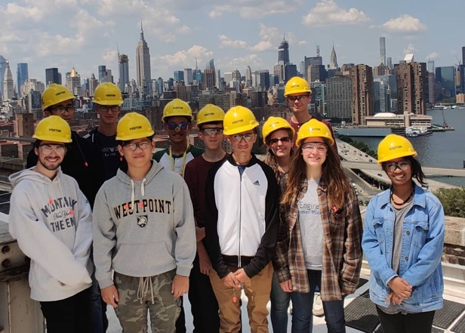
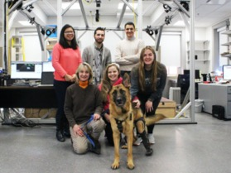

IEEE Foundation
Realize the full potential of IEEE.
Making impacts across multiple initiatives and around the world:
Illuminate the possibilities of technology by using it to address global challenges
Educate the next generation of innovators and engineers
Engage a wider audience in understanding the value of engineering and technology
Energize innovation by celebrating technological excellence
Learn more: ieeefoundation.org

Slide 74

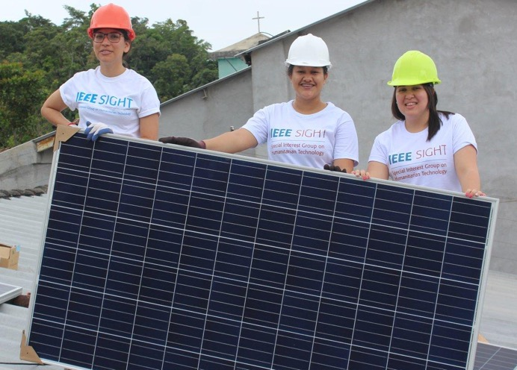
IEEE Humanitarian Activities Committee (HAC)
Inspiring, connecting, and empowering IEEE volunteers
IEEE HAC provides leadership and resources that inspire and enable IEEE volunteers around the world to carry out and support impactful humanitarian technology and sustainable development activities at the local level.
IEEE HAC’s work focuses on:
Raising awareness – IEEE HAC engages in outreach efforts so that existing and potential IEEE members know how they can use their technical skills for social good.
Providing training – Educational materials and opportunities allow humanitarian technology and sustainable development activities participants to obtain necessary skills.
Supporting IEEE humanitarian technology and sustainable development activities – from 2016-2020 IEEE HAC awarded over US$2.66M in funding to 329 projects and events.
Strengthening the sustainable development community through collaborations within, and beyond, IEEE.
Learn more: hac.ieee.org

Slide 75

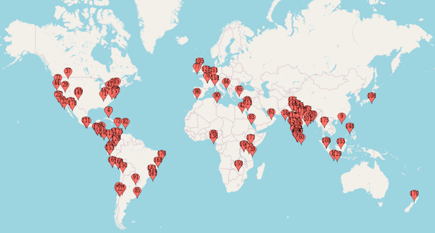
IEEE Special Interest Group on Humanitarian Technology (SIGHT)
Connecting a global network of technically-trained individuals
SIGHT is a popular feet-on-the-ground initiative operating within IEEE HAC. SIGHT’s global network of volunteers' partner with underserved communities and local organizations to leverage technology for sustainable development.
There are 17,500+ individual SIGHT members in 119 countries— approximately 75% are students or graduate students.
SIGHT encourages members to form groups to:
  learn about sustainable development
  build relationships within their local communities
  implement projects that utilize technology to tackle key challenges the community is facing
Since SIGHT’s inception in 2011, over 180 SIGHT Groups have been established in 53 countries.
“We gained knowledge, improved technical skills, expanded our network, and made bonds with the community.
We encourage anyone willing to help implement humanitarian technology projects—we guarantee you will have
a great experience.”
—SIGHT Project participant from El Salvador
Learn more: sight.ieee.org

Slide 76
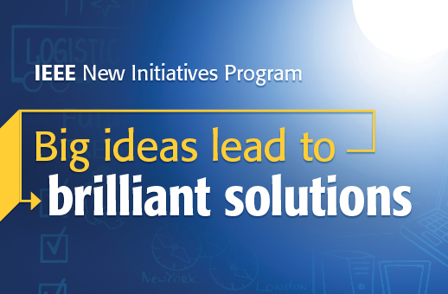
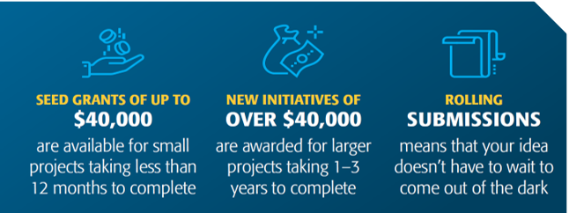
IEEE New Initiatives Program
Big ideas lead to brilliant solutions
The New Initiatives program supports potential new IEEE initiatives, services, or products which could have lasting impact on IEEE:
Increasing IEEE's connectivity to the industry
Engaging and recruiting members
Creating innovative education opportunities
Increasing the visibility of IEEE and its relevance to different communities
Learn more: ieee.org/initiatives

Slide 77

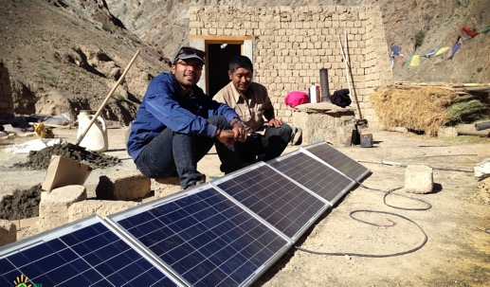

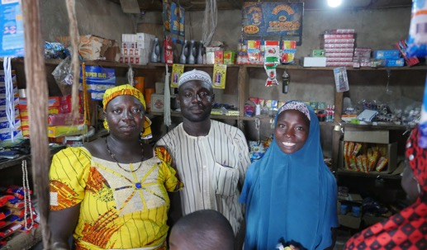
IEEE Smart Village
IEEE Smart Village is lighting up homes, businesses, and global classrooms—and empowering local economies using three pillars:
ENERGY
Provides renewable-energy solutions and necessary funding to local entrepreneurs to build electricity companies, assists the partners in establishing a sustainable business plan, and delivers ongoing training.
EDUCATION
Two complementary components crucial to helping stimulate sustainable community prosperity.
Development Practice graduate certificate in humanitarian engineering
Community Entrepreneurship vocational training to deploy, maintain, and franchise an IEEE Smart Village seed-funded micro-utility.
ENTREPRENEURSHIP
Our philosophy of empowering local entrepreneurs is unique in this philanthropic endeavor. These business owners have personally invested in the success of their community. The pride in accomplishments achieved together furthers the economic growth of the area.
Learn more: smartvillage.ieee.org

Slide 78

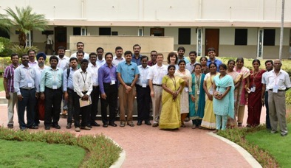
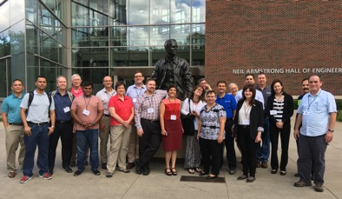
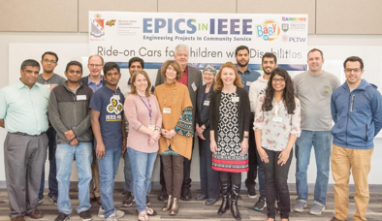
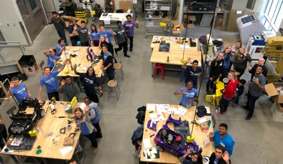
EPICS in IEEE
Connecting Engineering to Community Service
Solving community challenges through the power of technology and education, EPICS provides provide funding, support, mentorship, and visibility for engineering projects that transform communities across the globe.
Workforce development
Students get equipped for the workforce by defining, designing, building, testing, and deploying engineering-based solutions to real life community challenges.
Professional skills
Students develop in-demand professional skills such as communication, collaboration, leadership, project management, and time management.
Non-profit support
Volunteers provide much-needed knowledge, skills, resources, and innovative solutions in partnering with community organizations on projects.
Advancing STEM
Through service-learning engineering curriculum, the program improves STEM education and inspires pre-university students to pursue STEM-based careers.
Learn more: epics.ieee.org

Slide 79

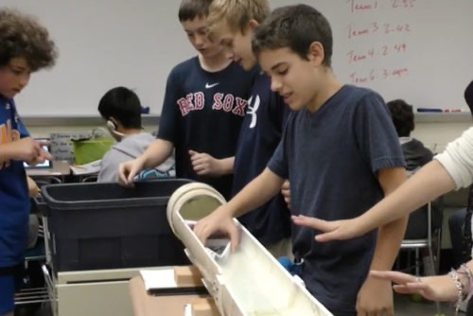

IEEE REACH
Raising engineering awareness through the conduit of history
IEEE REACH provides teachers and their students with educational resources that explore the history of technology and highlight how technology, throughout time, impacts society, culture, politics, and economics, and how, in turn, those social aspects influence technology.
The goal of the program is to improve technology and engineering literacy skills as they relate to the social context of technology and provide a new lens from which students may view engineering and technology as relevant to their lives and their future.
IEEE REACH Resources include Inquiry Units, or lesson plans (which include formative and summative performance tasks, excerpted documents, and civic actions), Primary Sources, Hands-on Activities, and short engaging classroom Videos (Multimedia). All resources are downloadable for use either in the classroom or for remote learning.
Learn more: reach.ieee.org

Slide 80

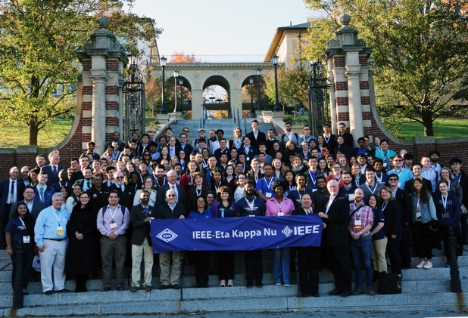

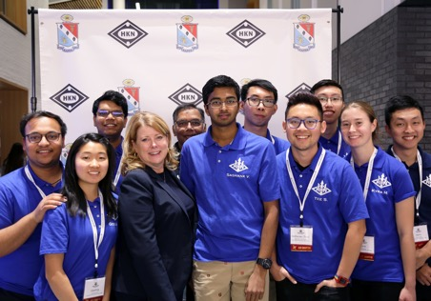

IEEE-HKN
IEEE Eta Kappa Nu (IEEE-HKN), the honor society of IEEE, promotes excellence in the profession and in education with ideals of Scholarship, Character, and Attitude.
IEEE-HKN members consist of students, alumni, and other professionals who have demonstrated exceptional academic and professional accomplishments.
Student members are selected on the basis of scholastic standing, character, and leadership.
Professional members are nominated by a current member and selected by virtue of their contributions.
Learn more: hkn.ieee.org

Slide 81
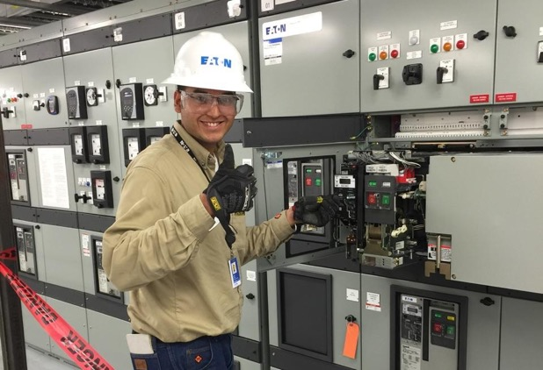



IEEE Power & Energy Society Scholarship Plus Initiative
The goal of the IEEE PES Scholarship Plus Initiative is to encourage undergraduate students to pursue careers in power and energy engineering.
Provides scholarships and real-world experience to undergraduates who are interested in power and energy engineering careers.
Attracts highly qualified engineering students to the field.
Paves the way for the individuals who will one day develop new green technologies, build the smart grid, and change the way we generate and utilize power.
Learn more: ee-scholarship.org

Slide 82




IEEE-USA Community Outreach Initiative (the MOVE Project)
MOVE Community Outreach is an emergency relief program committed to assisting victims of natural disasters with short-term communications, computer, and power solutions.
These temporary emergency relief provisions help those affected stay connected and make sure they can access the help they need.
Services include phone charging, internet & communications support, and lighting to disaster victims.
Learn more: move.ieeeusa.org

Slide 83




IEEE Life Members Committee (LMC)
Providing leadership in identifying and supporting interests of IEEE Life Members.
The IEEE Life Members Fund of the IEEE Foundation supports IEEE activities of interest to Life members, potential engineers, and engineering students. Generous donations are invested in initiatives that:
Excite students about STEM
Empower young minds to pursue careers in IEEE fields of interest
Preserve the legacy IEEE members helped create
Acknowledge peers for accomplishments
Encourage Life members and retirees to stay active in IEEE
Learn more: ieee.org/communities/life-members/fund.html

Slide 84

IEEE History Center
The mission of the IEEE History Center is to preserve, research, and promote the legacy of electrical engineering and computing technologies.
Learn more: ethw.org

Slide 85
Awards
Membership
Communities
Conferences
Publications
Standards
Education
Career Resources
Humanitarian and Philanthropic Goals
Awards
Industry
IEEE Corporate Awards recognize leaders and visionaries who have paved the road of discovery.

Slide 86




IEEE Corporate Awards Programs
Accomplishments in IEEE’s fields of interest are recognized with annual presentations for extraordinary contributions to technology, society, and the engineering profession.
Each award has a unique mission and criteria—and offers the opportunity to honor distinguished colleagues.
MEDALS
RECOGNITIONS
TECHNICAL AWARDS
IEEE Medals, Recognitions, and Technical Field Awards are sponsored by donors, corporate partners, and IEEE Societies & Organizational Units.
Learn more: corporate-awards.ieee.org

Slide 87





IEEE Medals
IEEE Medals are the highest awards presented within IEEE. The highest honor is the IEEE Medal of Honor, which recognizes an individual for an exceptional contribution or extraordinary career in the IEEE fields of interest.
IEEE Medals embrace significant and broad IEEE interests and purposes. They are presented to individuals or teams for outstanding technological innovations and career achievements that have advanced technology for the benefit of humanity.
Past recipients of the IEEE Medal of Honor, have included such visionaries as:
Guglielmo Marconi
(1920, for radio telegraphy)
William Shockley
(1980, for junction, analog, and junction field-effect transistors)
Andrew S. Grove
(2000, for pioneering research in metal oxide semiconductor devices
and technology)
Gordon E. Moore
(2008, for pioneering technical roles in integrated-circuit processing, and leadership in the development of MOS memory, the microprocessor computer, and the semiconductor industry)
Mildred Dresselhaus
(2015, for leadership and contributions across many fields of science and engineering)
Learn more: corporate-awards.ieee.org

Slide 88


IEEE Recognitions & Technical Fields Awards
Honoring individuals, teams, and organizations that advance technology for humanity.
IEEE Recognitions are presented for service and/or contributions within IEEE fields of interest.
These are presented in the following categories:
IEEE Service Awards (Haraden Pratt & Richard M. Emberson Awards)
IEEE Corporate Innovation Award (to an organization)
IEEE Theodore W. Hissey Outstanding Young Professional Award
IEEE Eric Herz Outstanding Staff Member Award
IEEE Honorary Membership
IEEE Technical Field Awards are awarded
for contributions or leadership in a specific field of interest of the IEEE.
They are narrower in scope than the IEEE Medals.
Technical Field Awards Categories:
Communications, Signal Processing, Control and Information
Computer-Related Technology and Robotics
Emerging Technologies, Industrial Electronics
Materials, Devices, Microelectronics, and Photonics
Power and Energy Systems
Biomedical Technologies, Instrumentation and Measurement, Standards, and Education
Learn more: corporate-awards.ieee.org

Slide 89
Industry Focus
Membership
Communities
Conferences
Publications
Standards
Education
Career Resources
Humanitarian and Philanthropic Goals
Awards
Industry
IEEE brings value to companies and workforces.

Slide 90

Value to Companies & Workforces
Information that is reliable
Company value
IEEE Xplore saves time and money by letting companies bring products to market sooner
Workforce value
IEEE Xplore provides access to cutting-edge and trusted research via IEEE journals, transactions, and magazines, conference Proceedings, educational courses, and eBook collections
Company & Workforce value
IEEE Standards ensures compliance from the start of any technology project
Education for the way the industry works
Company & Workforce value
  IEEE offers a wide range of learning opportunities, from practical training to online course series, helping individuals and companies keep up with the demands of changing technology
Global network of experts
Company value
IEEE’s global reach lets you connect across multiple markets and industries
Workforce value
IEEE lets you collaborate with over 400,000 members across 160 countries and 39 technology-specific societies
Network with global technology professionals by location, technical interests, or career pursuits via
IEEE Collabratec or in the IEEE App

Slide 91

Research, Industry Trends, and News
IEEE provides valuable resources and tools for professional engineers across multiple industries and technologies.
Industry standards access
Patent and intellectual property insights
Trend papers
IEEE conferences and industry
Trusted technology research via IEEE Xplore

Slide 92

Career and Professional Development Resources
IEEE can help those who work in the engineering sciences, research, and technology areas.
Emerging technology information with
IEEE Future Directions
Entrepreneurial and startup aids from
IEEE Entrepreneurship Initiative
Educational resources
Career opportunities and tools
Connections with industry technical professionals

Slide 93

Training for Industry Professionals
IEEE courses help industry professionals, and their companies, stay up-to-date on the latest technologies.
Increase attendance at your trainings and
meetings by offering IEEE credentials and career advancement opportunities
Participants and attendees of IEEE-sponsored events can earn:
  Continuing Education Units (CEU) and Professional Development Hours (PDH) through the IEEE Learning Network
  Certificates of Participation
  Digital Badges
Visit ieeexplore.ieee.org
Notes:
IEEE education programs are part of our commitment to providing members with lifelong continuing education.
IEEE professionals around the globe come to IEEE so they are better able to learn, excel, keep up to date, and partner for success.
Presenter, additional notes:
All online courses will be available through IEEE Xplore. http://ieeexplore.ieee.org
Programs are available for purchase via a perpetual license.
Specially-priced bundle available including companion programs Cyber Security for Today’s Environment and Hacking Your Company: Ethical Solutions to Defeat Cyber Attacks.
By teaming up with the IEEE Credentialing Program for your talks, programs, tutorials, and short courses at your next meeting or event, you can offer your attendees a way to stay current, expand their knowledge base, and increase opportunities for career advancement.
Participants and attendees of IEEE sponsored events can earn:
Continuing Education Units (CEU)
Professional Development Hours (PDH)
Certificates of Participation
To determine if your educational event is eligible for CEUs or PDHs, email us at eab-ceuadmin@ieee.org.

Slide 94






IEEE Corporate Partnership Program (IEEE CPP)
Companies can strengthen business intelligence, workforce development, and public visibility programs
Exclusive corporate partners with IEEE CPP will be able to:
Leverage the full benefit of the global reach and technical expertise of IEEE
Foster innovation and keep your global workforce on top of the latest technology advances
Engage and develop your technical employees
Receive on-demand access to some of the year’s most essential plenary sessions at IEEE conferences
Influence technology development and help define standards
Celebrate leaders in the engineering profession, connect with innovators, and learn from visionaries
BUSINESS DEVELOPMENT
Networking
Business Intelligence
Emerging Market Development
PUBLIC VISIBILITY
Thought Leadership
Foundation Leadership
Branding
WORKFORCE DEVELOPMENT
Membership Management
IEEE Social Good Activities
Professional Development
Retention & Recruitment
Learn more: ieee.org/membership/ieee-corporate-partnership-program.html
94

Slide 95
Learn more: ieee.org

